Slide 1
A Level Computer science

Slide 2
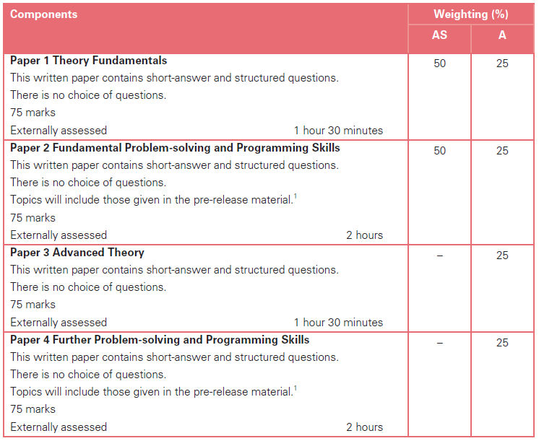
Computer science syllabus (9608)
Advanced Level (AS+A2)

Slide 3
1.1 number

Slide 4
Objective
show understanding of the basis of different number systems and use the binary, denary and hexadecimal number system

Slide 5
Denary number
Using 0-9 (base-10 system)
306 = 3*10²+0*10¹+6*10⁰

Slide 6

Binary number
Using 0 and 1 (base-2 system)
The binary digits are referred to as ‘bits’
All data inside a computer system are stored and manipulated using a binary code
$9 = 1∗2^{3}+0∗2^{2}+0∗2^{1}+1∗2^{0}$

Slide 7
Hexadecimal
Hexadecimal:/ˌheksəˈdesɪml/
Uses the digits 0 – 9 and letters A – F.
Each hex bit need 4 binary bits to represent.
e.g. F (decimal 15) = 1111
This make the representation more compact and more intelligible

Slide 8
Hexadecimal
Denary / Decimal | Binary | Hexadecimal
1 | 0000 0001 | 1
2 | 0000 0010 | 2
etc ….
9 | 0000 1001 | 9
10 | 0000 1010 | A
11 | 0000 1011 | B
etc ….
15 | 0000 1111 | F
16 | 0001 0000 | 10

Slide 9
Think about this:
Easy mode: Why do we use denary number?
Mid mode: Why do we use binary number? Recall the story from ‘Three Body Problem’.
Hard mode: Why do we use hexadecimal?

Slide 10
Objective
convert a number from one number system to another

Slide 11
Binary -> denary
The core idea is that the number of objects represented by these coding methods does not change.
10011
1*2⁰+1*2¹+0*2²+0*2³+1*2⁴=1+2+16=19=9*10⁰+1*10¹
Exercise
10001
11101

Slide 12
Denary -> Binary
61
=32+16+8+4+1
=(111101)₂
Exercise
57
128

Slide 13
Binary -> Hexadecimal
The number of objects represented by these coding methods does not change.
Translate each group of 4 bits into denary and then into hexadecimal.
e.g. 10010010 (binary) = (1001)(0010) = (9)(2) = 92 (hexadecimal)
Exercise
10011100
11010011
Notes:
abcdef = 10,11,12,13,14,15
10011100 = (9)(12) = 9C
11010011 = (13)(3) = D3

Slide 14
Hexadecimal->Binary
Translate a hexadecimal bit into a group of 4 bits
e.g. A3=1010 0011
Exercise
B5=
23=
Notes:
B5 = 1011 0101
23 = 0010 0011

Slide 15
Decimal(denary) -> Hexadecimal e.g. 75
Use the column headings 1, 16, 256, … (16^n) (see: denary -> binary)
75 < 4096 & 75 < 256 so put a 0.
4096 | 256 | 16 | 1
0 | 0
75 > 16 & 75 / 16 = 4 r 11
11= B (hexadecimal)
4096 | 256 | 16 | 1
0 | 0 | 4 | B
So 75 = 4B (Hexadecimal)

Slide 16
Denary -> Hexadecimal: An alternative way
An alternative way to convert from denary to hexadecimal is to convert to binary, and then convert from binary to hexadecimal.
Notes:
将十进制转换为十六进制的另一种方法是将其转换为二进制，然后执行上述操作。

Slide 17
Denary -> Hexadecimal Question:
Translate 101 (denary) into hexadecimal.
65
Translate 64 (denary) into hexadecimal.
40

Slide 18
Hexadecimal -> Denary e.g. BD
4096 | 256 | 16 | 1
0 | 0 | B | D
0 | 0 | 11 | 13
B = 11 , D = 13
BD = (11 * 16) + 13
= 176 + 13
= 189 ( in denary)

Slide 19
Hexadecimal -> Denary Question:
Translate 96 (hexadecimal) into denary.
150
Translate the 75 (hexadecimal) into denary.
117
Translate the 30 (hexadecimal) into denary.
48

Slide 20
Objective
Express a positive or negative integer in 2’s complement form

Slide 21
Representing Negative Numbers
As there is no third symbol available to store a negative symbol explicitly in computer(bit is the only thing we have), using a bit to show if a number is negative or not is helpful.
We name this bit the ‘Sign Bit’
We use the leftmost bit.
If the ‘Sign Bit’ is 1 then the number is negative, if it is 0 then it is positive.

Slide 22
Sign and Magnitude representation
Another name is ``true code’’
3 = 0 0000011
-3 = 1 0000011
Sign Bits

Slide 23
Sign and Magnitude Problem
The problem is that arithmetic (四则运算) is inconvenient:
e.g. +3 + -3 = 0
but
0 0000011
+1 0000011
1 0000110 i.e. not 0

Slide 24
One’s Complement 1的补码，中文里叫反码
Negative denary to binary
The leftmost bit is fixed as 1.
The binary form of the absolute value of the negative number is obtained first.
获得该负数的绝对值的二进制形式。
Ignore the leftmost one, flip all other bits, where ``flip’’ means change 0 to 1 or 1 to 0.
将最左边的1保留，将其他所有位翻转。
Question:
How many bits left for us to code a number?

Slide 25
Example: -5
The leftmost bit is fixed as 1 ->1 _ _ _ _ _ _ _
The binary form of the absolute value of the negative number is obtained first.
5 = 1 0000101
Ignore the leftmost one, flip all other bits, where ``flip’’ means change 0 to 1 or 1 to 0.
1 1111010
-5 = 11111011

Slide 26
Two’s Complement 2的补码，中文里叫补码
This is a better way to represent negative numbers.
Negative denary to binary
Obtain the one’s complement
Add 1 to the obtained number

Slide 27
Two’s Complement
So:
0 0000011 = 3
0 0000010 = 2
0 0000001 = 1
0 0000000 = 0
1 1111111 = -1
1 1111110 = -2
1 1111101 = -3
Sign Bit

Slide 28
Two’s Complement
Now the arithmetic works as it should:
0 0000011 = 3
+ 1 1111101 = -3
0 0000000 = 0
Note: The leftmost 1 has to be ignored, all the meaning of it is to give the ``sign’’

Slide 29
Alternative way of using Two’s Complement
The MSB (Most Significant Bit) stays as a number, but is made negative. This means that the column headings are
-128 64 32 16 8 4 2 1
+117 does not need to use the MSB, so it stays as 01110101.
-117 = -128 + 11
= -128 + (8 + 2 + 1)
Fitting this in the columns gives 10001011

Slide 30
Comparison of these three kind of code
True code （原码）
-1 True code：10000001
One’s complement （反码）
The binary number obtained by subtracting（按位减去） each digit in a binary number from 1
-1 in one’s complement is 11111110
Two’s complement （补码）
-1 in two’s complement is 11111111

Slide 31
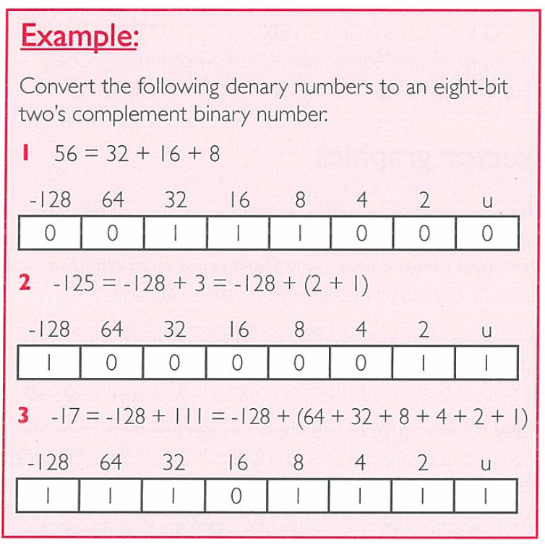
Exercise
56
-125
-17

Slide 32
Answer

Slide 33
Discussion
What is the two’s complement of the binary value 1000?
State in denary, the range of integer values that it is possible to represent in two’s complement integers using a single byte.
Lowest value:
Highest value:

Slide 34
Exercise
A particular computer stores numbers as 8 bit, two’s complement, binary numbers.
01011101 and 11010010 are two numbers stored in the computer.
Write down the decimal equivalent of 11010010.
Add the two binary values together and comment on your answer.

Slide 35
Answer
-46
00101111 = +47
A positive and negative have been added together and the result is positive.
Because the larger value was positive.
There was carry in and out of MSB therefore ignore carry out, (result is correct).

Slide 36
Objective
express a denary number in Binary Coded Decimal (BCD) and vice versa
用二进制编码的十进制(BCD)表示十进制数，反之亦然
describe practical applications where BCD is used
描述BCD的实际应用

Slide 37
BCD (Binary Coded Decimal)
Represents numbers only by representing each decimal digit by a 4 bit binary code.
Decimal | Binary
0 | 0000
1 | 0001
2 | 0010
etc....
9 | 1001
e.g. 19 is shown by:
1 9
0001 1001

Slide 38
Denary -> BCD Question
Convert 398602 (denary) into BCD.
0011 1001 1000 0110 0000 0010

Slide 39
BCD -> Denary e.g. 001001110110
Split into groups of 4.
(0010) (0111) (0110)
Translate each group of 4 into decimal in the same fashion as binary -> decimal.
2 7 6
So 001001110110 = 276 (denary)

Slide 40
BCD -> Denary Question
Convert 100000110101 (BCD) into denary.
835

Slide 41
BCD (Binary Coded Decimal)
Advantages:
Easy to convert from BCD to decimal:
As a BCD number is split into groups of four bits and each group converted directly to the corresponding decimal digit
Used in some pocket calculators

Slide 42
BCD (Binary Coded Decimal)
Advantages:
When storing fractional numbers in BCD no ‘rounding’ occurs:
在BCD中存储小数时，不会出现“舍入”:
As each digit is encoded separately so as many bits as necessary are used to represent the complete number
Used in business applications where every significant digit has to be retained in a result.
用于必须保留结果中每个有效数字的业务应用程序。

Slide 43
BCD (Binary Coded Decimal)
Disadvantage
More bits are required to store each number than pure binary e.g.
19 in BCD = 0001 1001 (8 bits)
19 in normal binary format = 10011 (5 bits)
Difficult to calculate with:
e.g. 1 0000 0001
+ 19 0001 1001 20 0001 1010
‘10’ is wrong
invalid

Slide 44
BCD (Binary Coded Decimal)
Only the first ten of 16 combinations（组合） of 4 digits are used to encode the decimal digits ‘0’ to ‘9’
Therefore whenever the sum of two binary digits is >9, 6 has to be added to skip over the 6 unused codes.
e.g. 1 0000 0001
+ 19 +0001 1001 20 0001 1010
+ 0110
0010 0000 i.e. 20 which is correct

Slide 45
For example
Use BCD arithmetic（四则运算）
14+22
19+21
19+29
37+22
19+27
Hard mode: 787+894 (16bit)

Slide 46
Objective
show understanding of, and be able to represent, character data in its internal binary form depending on the character set used (Candidates will not be expected to memorise any particular character codes but must be familiar with ASCII and Unicode.)
根据所使用的字符集，理解并能够表示内部二进制形式的字符数据(不需要记住任何特定的字符代码，但必须熟悉ASCII和Unicode)。

Slide 47
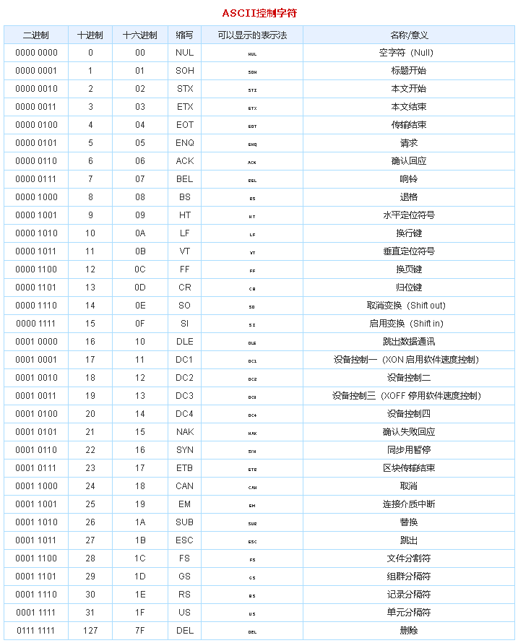
ASCII

Slide 48
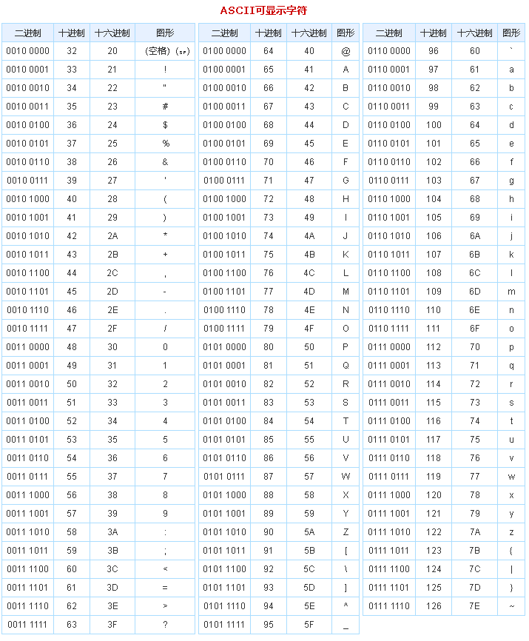
ASCII

Slide 49
Questions:
The ASCII code for the letter N is 0100 1110. Show how to represent this in
a) denary
78
b) hexadecimal
= (0100) (1110) = (4)(14) = 4E

Slide 50
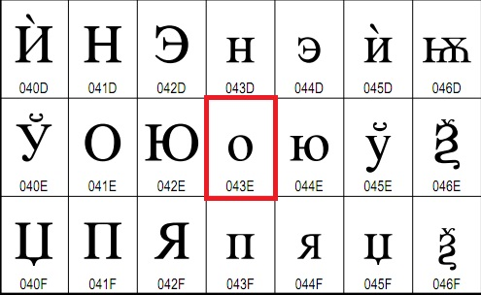
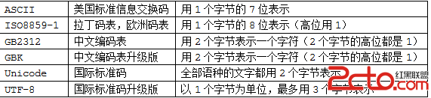
Unicode
Two-byte code

